Slide 1
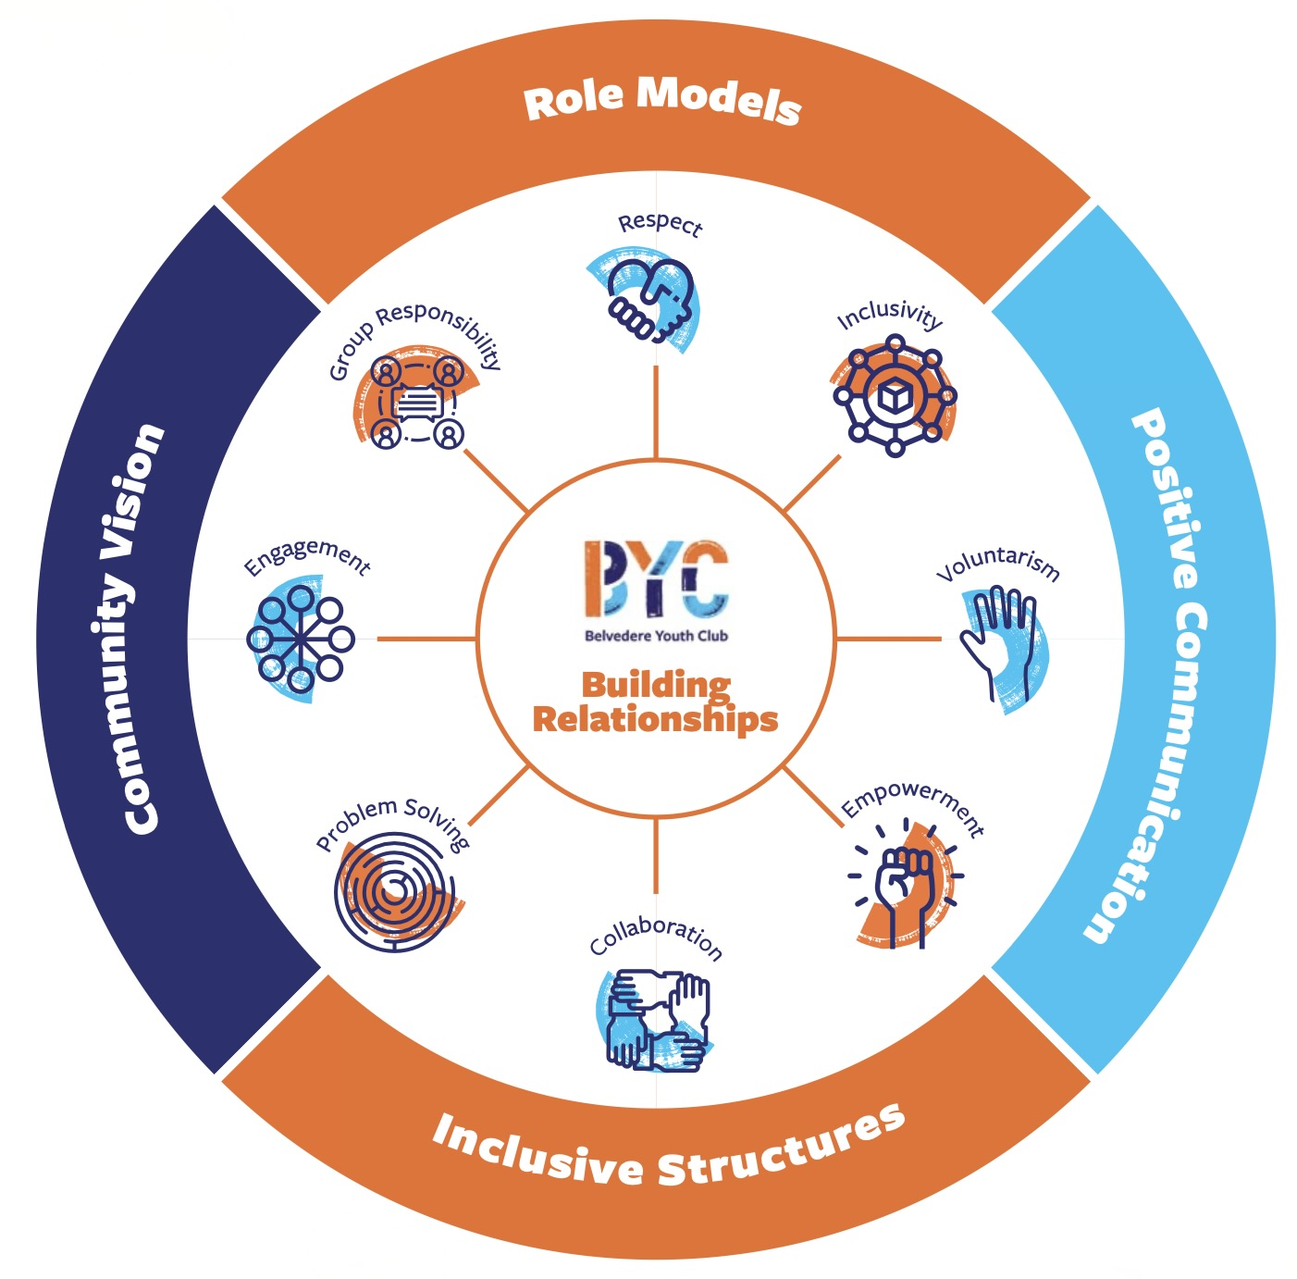

Introduction to Restorative Practices
BYC Transition Year – Work experience

Slide 2

Session 2
Building relationships

Slide 3


Opening Circle
Energy level on a scale of 1 to 10
Someone you admire and why

Slide 4
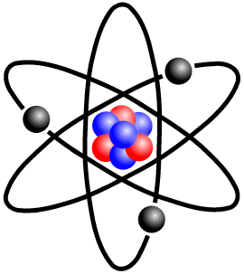
Energiser: Electron repulsion

Slide 5
Relationships
Individually think for a few minutes: How does it look like and feel like when you have a good relationship with someone?
Pair and Share

Slide 6
Building relationships
Small group exercise: what works well for you to build good relationships with people around you (even when you are not best friends).

Slide 7
My best day
Individually and silently, imagine what would be your ideal day? What would you do, when, with whom etc... You can spend as much money as you want. You won’t have to share you ideal day with others.
Now in 2 small groups, imagine how you would spend your ideal day as a group, together. You can spend as much money as you want

Slide 8
My best day
Consider the following questions and feel free to share with the group:
How close was your personal ideal day to your group day?
What did you give up? What did you gain?
Is it similar to real life in any way?

Slide 9
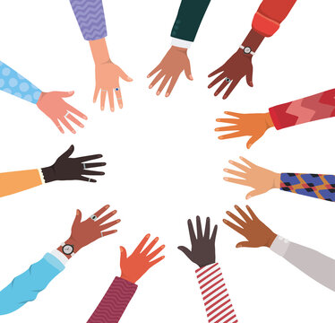
Energiser: touch blue

Slide 10
Barriers
Individually think for a few minutes: What are the biggest obstacles to build good relationships?
Pair and Share
Discuss as a group the best ways to overcome the obstacles

Slide 11
Plan for today
Plan for the day
What is expected of you
What support you can get
Do you have any question?

Slide 12
Closing Circle
Energy level on a scale of 1 to 10
One thing you are taking away from the session

Slide 13
Closing Circle
Energy level on a scale of 1 to 10
One thing you are taking away from the session

